Slide 1
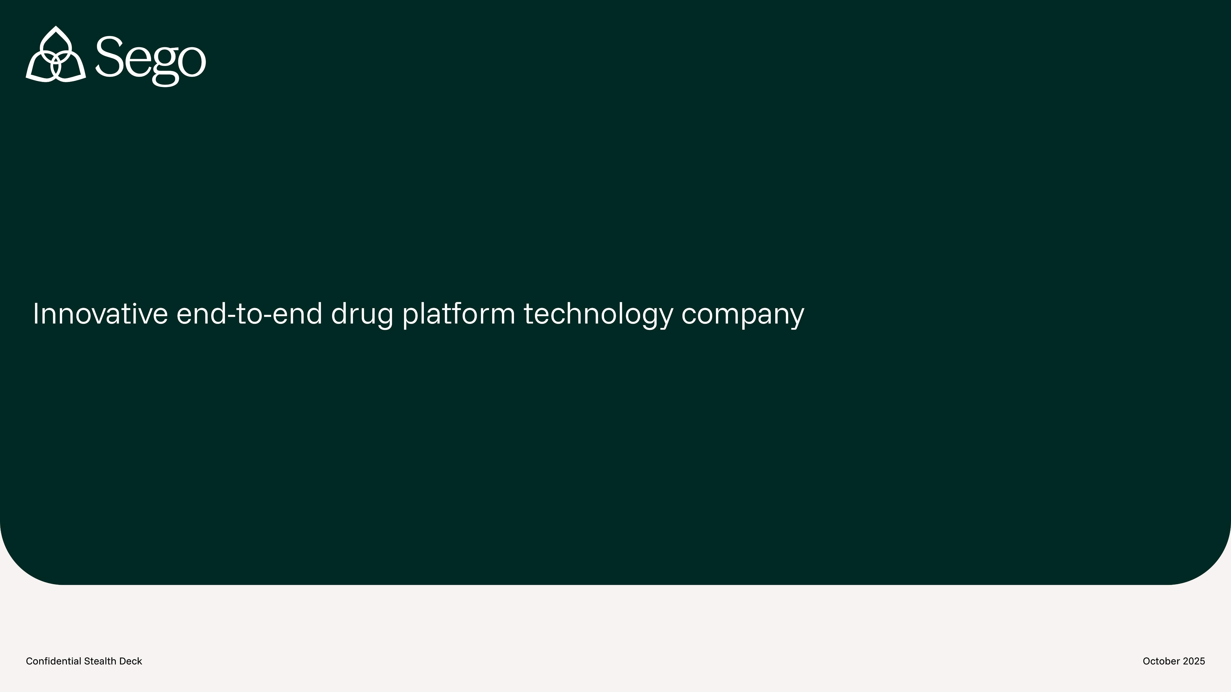

Sego Therapeutics
Integrating radiopharmaceutical discovery, development and commercialization for better outcomes
May 2026

Slide 2
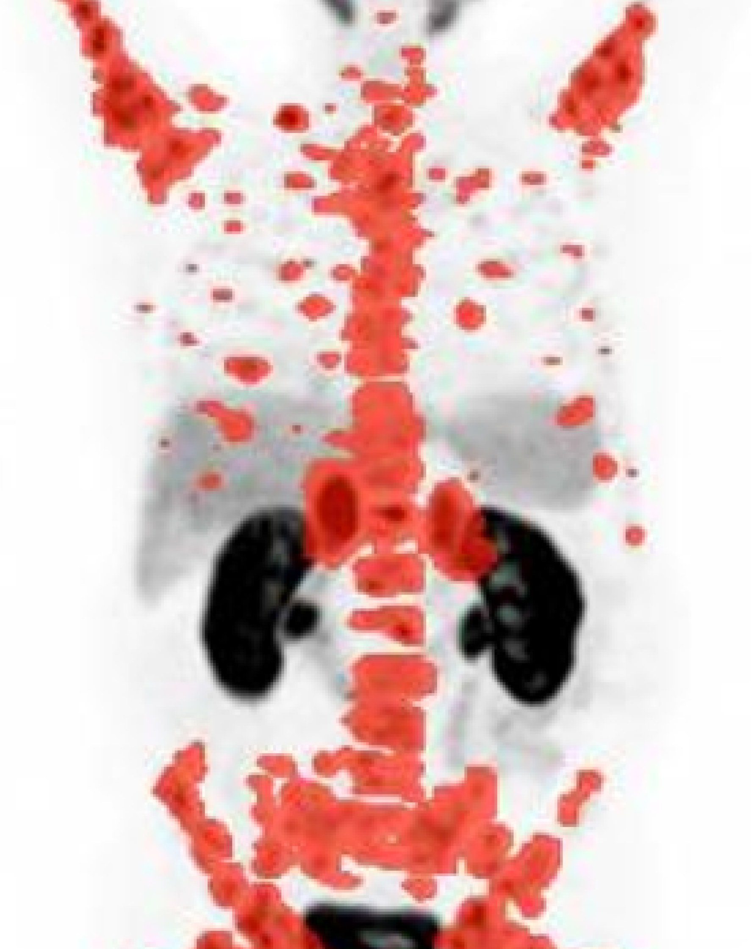
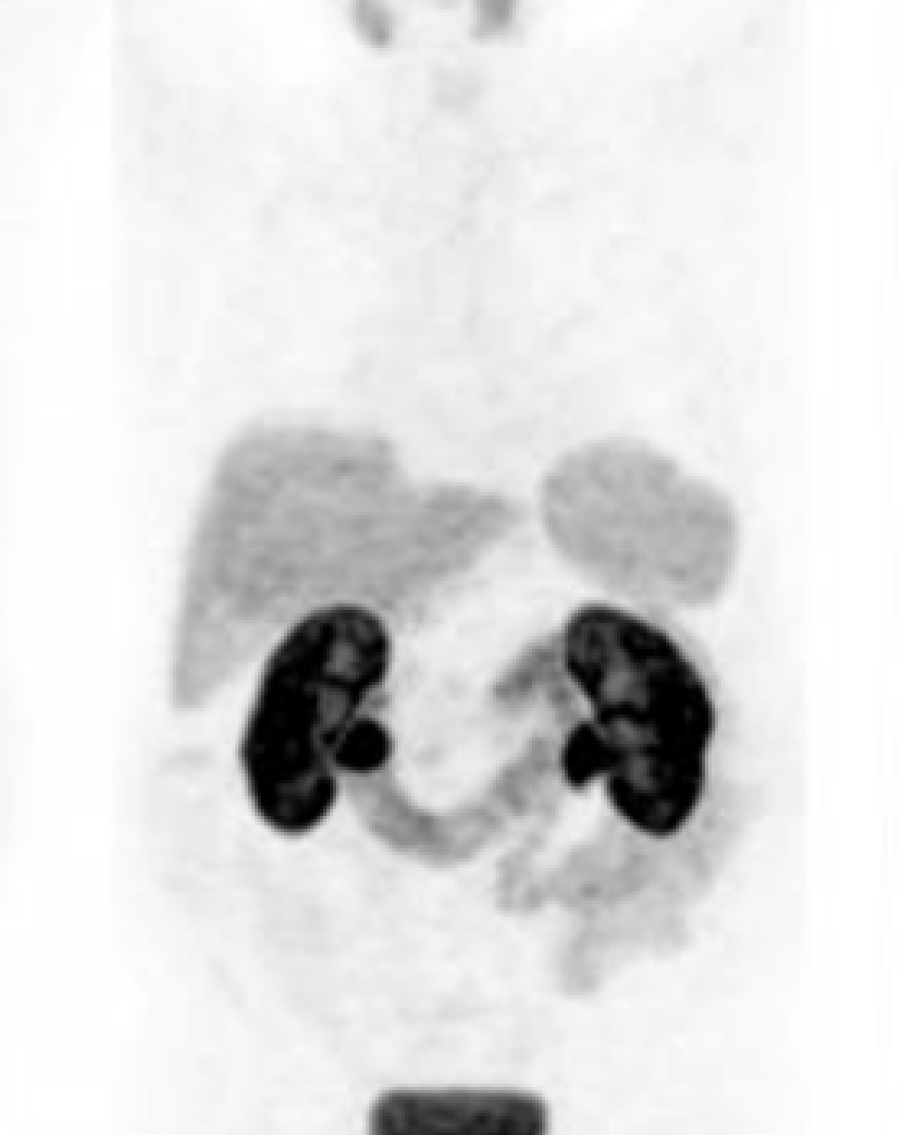

Founding team have delivered a paradigm shift for patients with prostate or neuroendocrine cancers
See It
Treat It
Delivers tumor-killing radiation to metastatic, castration resistant prostate cancer (mCRPC) tumors via IV administration
Reshaped prostate cancer standard of care in later lines and now moving earlier
2x progression free survival for patients
Expected peak sales >$5B
mCRPC tumors
Prostate cancer before RLT
A PET scan prior to treatment showing widespread mCRPC tumors throughout the body
After RLT
A follow up scan in the same patient indicating a massive reduction in tumor burden after treatment
Source: Hofman et al, JNM 59, S1, p. 531 2018

Slide 3
Sego will overcome limiting constraints in RLT development
Opportunity
Constraints in RLT development
Targets are selected agnostic of the properties of RLT
Pharmacology of targeting agents
Clinical translation & trial execution
Supply chain complexities
RLTs make up only 2% of clinical trials in oncology but are set to grow over the next decade
RLT trials are concentrated against 2 targets in 2 tumor types. White space opportunity exists outside these two
2% — RLT
39% — Small molecules
8% — Antibody drug conjugates
34% — Antibody
17% — Other
41% — Prostate
18% — Neuroendocrine
41% — Other tumor types
Source: IQVIA Whitepaper, 2024 "Breaking New Ground: Advancing Cancer Care with Novel Therapeutic Modalities”

Slide 4
Our experience in RLT points to four value-driving engines for Sego that allow us to address those white spaces
Differentiated Approach
Constraints in RLT today
Sego’s engines
Targets for RLT should be selected with unique criteria versus other modalities
Narrow focus on optimizing ligand affinity, at the expense of other key attributes
Missed opportunities to utilize First-in-Human (FIH) studies to accelerate clinical development
Complexity in supply chain & logistics resulting in delays, failed production batches & increased COGs
Bespoke for RLT target selection Diverse pipeline of targets, selected based on expression, biology, landscape & feasibility
Harmonization of affinity, PK, target biology & isotope characteristics Achieved with our proprietary, high-throughput screening & in vitro/vivo facilities
Clinical translation: bench to bedside (and back) Feed learning from clinic back to research. Conduct early derisking in FIH imaging studies
Integrated commercialization & supply capabilities In-house GMP capabilities & proximity to isotope supply for seamless asset development
1
2
3
4

Slide 5
Multi-asset pipeline creates compounding value across indications
What We Are Building
[Slide to be built]

Slide 6
Our Future
The value of a single RLT asset starts high & rises rapidly as it progresses
(illustrative)
 | Year 1 | Year 2 | Year 3 | Year 4 | Year 5 | Year 6 | Year 7 | Year 8
Pgm 1
Preclinical
Ph 0
Ph 1 / 2
Pivotal
NDA
Mouse efficacy data
FIH Data
5 compounds
RP2D selection
Interim
Efficacy Data
1st Human
Efficacy Data
Interim data
Full data
Approval
Value inflection points
DC selected
AACR Presentation
SMMNI or EANM Presentation
ASCO Presentation
ASCO Presentation
Seed
Series A
Series B
Series C / IPO
Program Value By Stage of Development – Comparative Deals
Preclinical
Ph 0
Ph 1 / 2
Pivotal
$4B
4
6
$4.1B
BMS · RayzeBio
$3.9B
Novartis · Lutathera
Value
10
$2.4B
AZ · Fusion
2
$2.1B
Novartis · Pluvicto
3
$1.7B
Novartis · Mariana
$1.35B
BMS · Philogen
4
X
Years to acquisition
5
$1.1B
Lilly · Aktis
3
$1.1B
Lilly · Radionetics
Asset led deal
11
$0.5B
Regeneron · Telix
Platform led deal
$0
Source: Company disclosures, public filings. Deal values as of announcement date. Illustrative timeline only.

Slide 7
Our Future
Seed will deliver transactable, clinical data on 2 programs, with more clinic-ready
Target | Indication | FIC/BIC | 2026 | 2027 | 2028
Target 1 | GU | BIC
Target 2 | GU | BIC
Target 3 | GI | FIC
Target 4 | Lung | FIC
Target 5 | Lung | FIC
Target 6 | Opportunistic BD or internal
Hit ID
H2L
LO
FIH Enabling
FIH Imaging
Work ongoing
Example clinical assets in dark green
Hit ID
H2L
LO
FIH Enabling
FIH Imaging
Work ongoing
Hit ID
H2L
LO
FIH Enabling
FIH Imaging
June screening start
Hit ID
H2L
LO
FIH Enabling
FIH Imaging
June screening start
Hit ID
H2L
LO
FIH Enabling
FIH
July screening start
FIH Enabling
FIH Imaging
Today
Timeline TBD, pending BD activities
Supported by Series A
Value inflection points
* Seed supports 2 programs advancing to FIH studies, exact programs TBD
1st FIH Study Initiates
2nd FIH Study Initiates
Series A

Slide 8
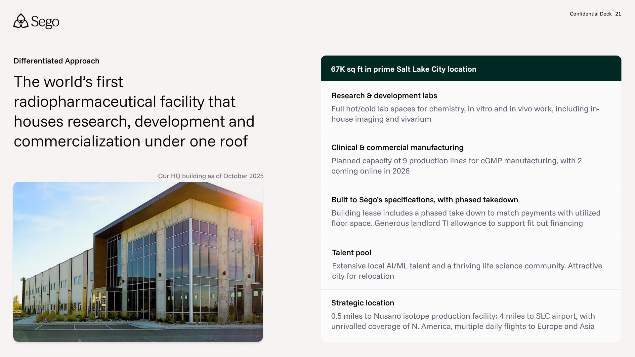
4
Vertical Integration

Slide 9
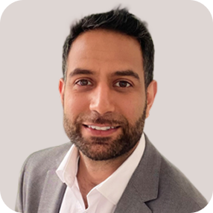
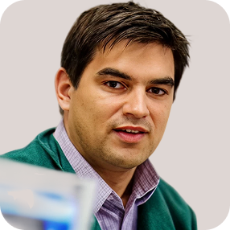
















15+ domain area experts led by 4 founders with deep domain expertise in radiopharma
Our Team
Jeevan Virk, CEO
Greg Mullen, PhD, CTO
Adam Badar, PhD, Head of Operations
Richard Tavaré, PhD, Head of Research
Pioneer in RLT field. Last role heading up RLT Strategy at market leader Novartis
19 years experience in radiopharma
Worked directly with founders at AAA
Central to research, development and commercialization platform for Pluvicto & Lutathera
Key player in 5 Novartis deals with Mariana Oncology ($1b+), Peptidream, Chengdu Baiyu, plus others
25 yrs of radiopharma R&D, clin dev and commercialization experience
Drove FDA approval of Nephroscan diagnostic
Translated multiple products into FIH, Phase 1 and 2 clinical studies
M&A: Out licenses to AAA/Novartis, exit of Theragnositics for $41M
C-suite experience, in licensing, IP, fundraising
15 yrs in nuclear medicine, oncology, technology development & innovation
Experience in product, partner, and customer development
Building and managing cross- functional consulting teams
Experience in operational and project management in Agile
15 yrs oncology diagnostic and therapeutic drug development in academia and pharma
Led to three molecules in imaging clinical trials
Acquired cyclic peptide company for capabilities at Regeneron
PhD Imaging Immunology

Slide 10
Wasatch Group: $20M founding investor building alongside Sego
Who We Are
[Slide to be built]

Slide 11
China JV: Near-term revenue and strategic optionality
The Ask
[Slide to be built]

Slide 12
Strong value trajectory towards revenue generation driven by three phases of flawless execution
Our Future Roadmap
+$4B
$1B
Benchmarked Valuation*
$375M
1–3 Years
3–5 Years
5+ Years
$100M
Build core business & research capabilities
Seed: $80M
Develop 6 pre-clin programs against innovative targets
Translate 2 programs to FIH imaging studies
Implement ML/AI capabilities to expedite discovery & development
Translate assets & broaden pipeline
Series A: $150M
Move 2-4 programs into Phase 1 & beyond
Replenish pre-clin pipeline with 6+ new programs
GMP manufacturing suite expansion & operation
Revenue-generating RLT biopharma
Series B:$250M
Readouts from first pivotal studies
Commercialize first assets
Full pipeline of programs from research through to clinical development generated through flywheel
*Benchmarks based on RayzeBio valuation step ups

Slide 13
The opportunity to invest
The Ask
[Slide to be built]

